Slide 1
Hierarchical Clustering
Agglomerative approach
Initialization:
Each object is a cluster
Iteration:
Merge two clusters which are
most similar to each other;
Until all objects are merged
into a single cluster
a
a b
b
a b c d e
c
c d e
d
d e
e
Step 0
Step 1
Step 2
Step 3
Step 4
bottom-up

Slide 2
Hierarchical Clustering
Divisive Approaches
Initialization:
All objects stay in one cluster
Iteration:
Select a cluster and split it into
two sub clusters
Until each leaf cluster contains
only one object
a
a b
b
a b c d e
c
c d e
d
d e
e
Step 4
Step 3
Step 2
Step 1
Step 0
Top-down

Slide 3
Dendrogram
A binary tree that shows how clusters are merged/split hierarchically
Each node on the tree is a cluster; each leaf node is a singleton cluster

Slide 4
Dendrogram
A clustering of the data objects is obtained by cutting the dendrogram at the desired level, then each connected component forms a cluster

Slide 5
Dendrogram
A clustering of the data objects is obtained by cutting the dendrogram at the desired level, then each connected component forms a cluster

Slide 6
How to Merge Clusters?
How to measure the distance between clusters?
Single-link
Complete-link
Average-link
Centroid distance
Distance?
Hint: Distance between clusters is usually defined on the basis of distance between objects.

Slide 7
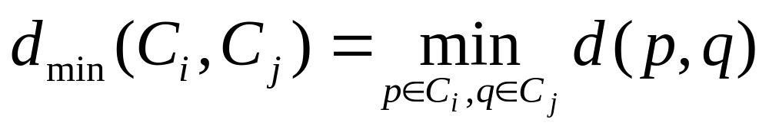
How to Define Inter-Cluster Distance
Single-link
Complete-link
Average-link
Centroid distance
The distance between two clusters is represented by the distance of the closest pair of data objects belonging to different clusters.

Slide 8
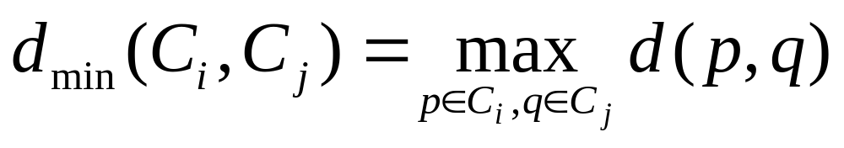
How to Define Inter-Cluster Distance
Single-link
Complete-link
Average-link
Centroid distance
The distance between two clusters is represented by the distance of the farthest pair of data objects belonging to different clusters.

Slide 9
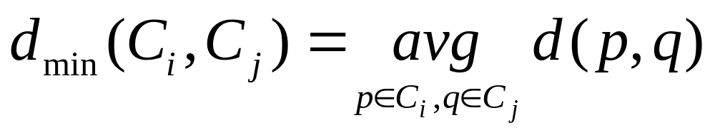
How to Define Inter-Cluster Distance
Single-link
Complete-link
Average-link
Centroid distance
The distance between two clusters is represented by the average distance of all pairs of data objects belonging to different clusters.

Slide 10
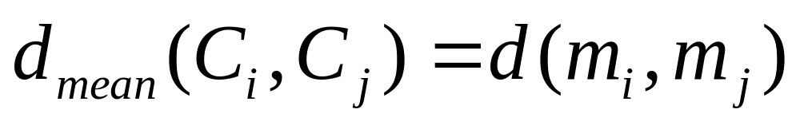
How to Define Inter-Cluster Distance
×
×
m_{i},m_{j} are the means of C_{i}, C_{j},
Single-link
Complete-link
Average-link
Centroid distance
The distance between two clusters is represented by the distance between the means of the cluters.

Slide 11
An Example of the Agglomerative Hierarchical Clustering Algorithm
For the following data set, we will get different clustering results with the single-link and complete-link algorithms.
1
5
3
4
2
6

Slide 12
Result of the Single-Link algorithm
1
5
3
4
2
6
1
3
4
5
2
6
Result of the Complete-Link algorithm
1
5
3
4
2
6
1
3
2
4
5
6

Slide 13
Hierarchical Clustering: Comparison
Single-link
Complete-link
5
1
4
1
3
2
5
5
5
2
1
2
2
3
6
3
3
6
1
4
4
4
Average-link
Centroid distance
5
1
5
4
2
1
5
2
2
5
2
3
6
3
3
6
4
1
1
4
4
3

Slide 14
Compare Dendrograms
Single-link
Complete-link
1 2 5 3 6 4
1 2 5 3 6 4
Average-link
Centroid distance
1 2 5 3 6 4
2 5 3 6 4 1

Slide 15
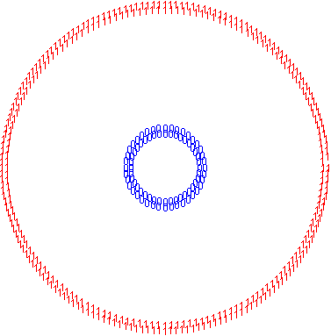
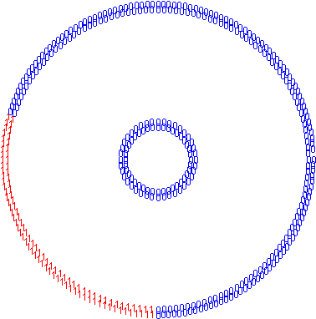
Effect of Bias towards Spherical Clusters
Single-link (2 clusters)
Complete-link (2 clusters)

Slide 16
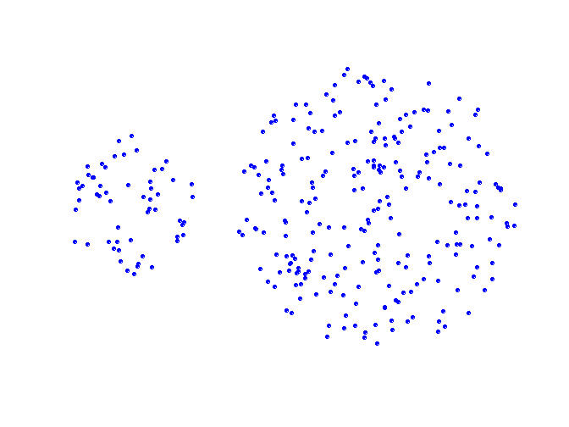
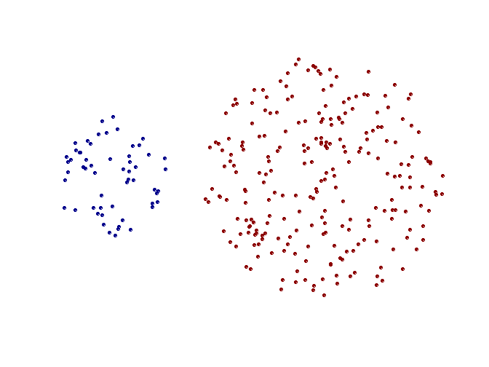
Strength of Single-link
Original Points
Two Clusters
Can handle non-global shapes

Slide 17
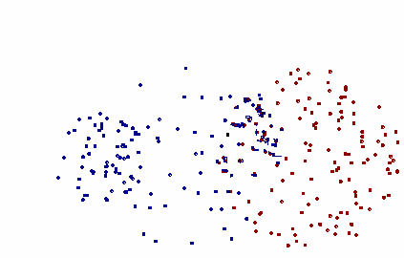
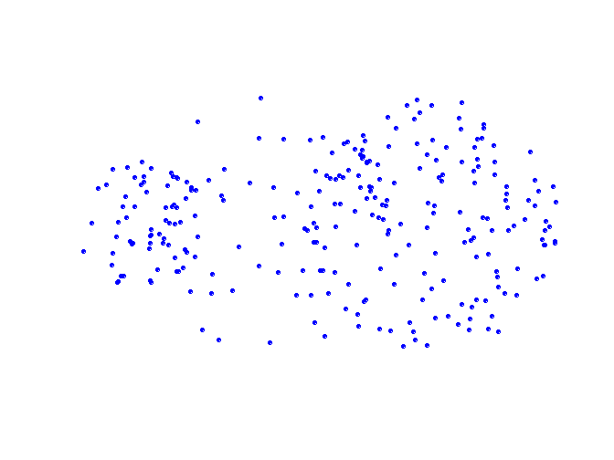
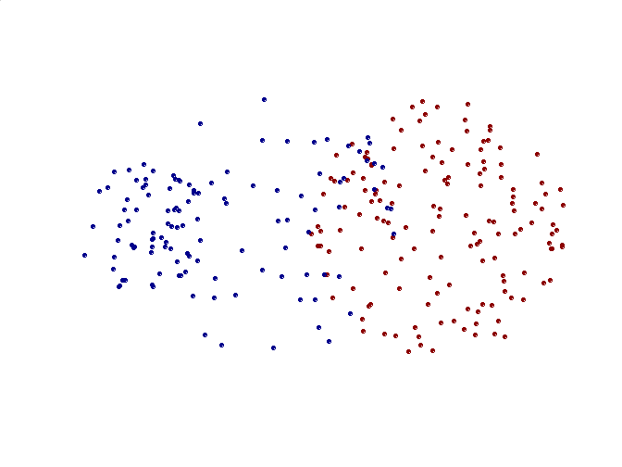
Limitations of Single-Link
Original Points
Two Clusters
Sensitive to noise and outliers

Slide 18
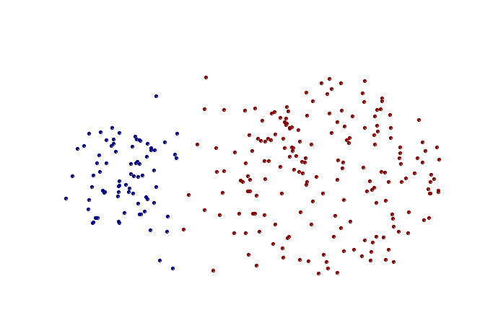
Strength of Complete-link
Original Points
Two Clusters
Less susceptible to noise and outliers

Slide 19
Which Distance Measure is Better?
Each method has both advantages and disadvantages; application-dependent, single-link and complete-link are the most common methods
Single-link
  Can find irregular-shaped clusters
  Sensitive to outliers, suffers the so-called chaining effects
Complete-link, Average-link, and Centroid distance
  Robust to outliers
  Tend to break large clusters
  Prefer spherical clusters

Slide 20
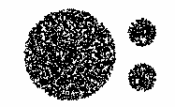
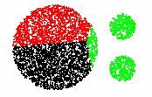
Limitation of Complete-Link, Average-Link, and Centroid Distance
The complete-link, average-link, or centroid distance method tend to break the large cluster.

Slide 21

AGNES (Agglomerative Nesting)
Introduced in Kaufmann and Rousseeuw (1990)
Implemented in statistical analysis packages; e.g., S+
Use single-link method
Merge nodes that have the least dissimilarity
Eventually all objects belong to the same cluster

Slide 22
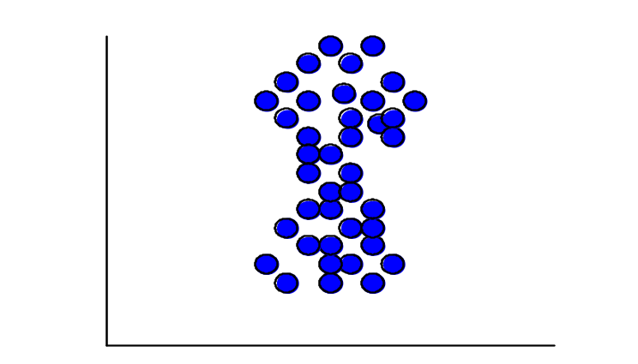
UPGMA
UPGMA: Unweighted Pair-Group Method Average.
Merge Strategy:
  Average-link approach;
  The distance between two clusters is measured by the average distance between two objects belonging to different clusters.
1
∑
∑
d
(
C
,
C
)
=
d
(
p
,
q
)
avg
i
j
n
n
Average
distance
i
j
p
∈
C
i
q
∈
C
j
n_{i},n_{j}: the number of objects in cluster C_{i}, C_{j}.

Slide 23
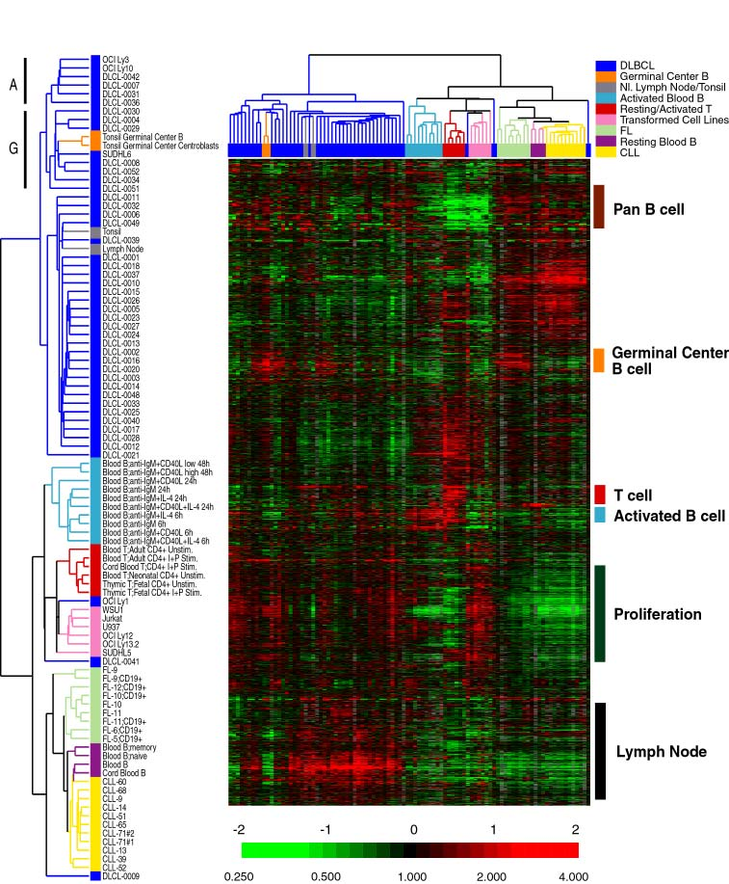
TreeView
UPGMA
Order the objects
The color intensity represents expression level.
A large patch of similar color indicates a cluster.
Eisen MB et al. Cluster Analysis and Display of Genome-Wide Expression Patterns. Proc Natl Acad Sci U S A 95, 14863-8.
http://rana.lbl.gov/EisenSoftware.htm
http://genome-www.stanford.edu/serum/fig2cluster.html

Slide 24
DIANA (Divisive Analysis)
Introduced in Kaufmann and Rousseeuw (1990)
Implemented in statistical analysis packages, e.g., S+
Inverse order of AGNES
Eventually each node forms a cluster on its own

Slide 25
DIANA- Explored
First, all of the objects form one cluster.
The cluster is split according to some principle, such as the minimum Euclidean distance between the closest neighboring objects in the cluster.
The cluster splitting process repeats until, eventually, each new cluster contains a single object or a termination condition is met.

Slide 26
Splitting Process of DIANA
Intialization:
Choose the object O_{h} which is most dissimilar to other objects in C.
2. Let C1={O_{h}}, C2=C-C1.
C
C2
C1

Slide 27
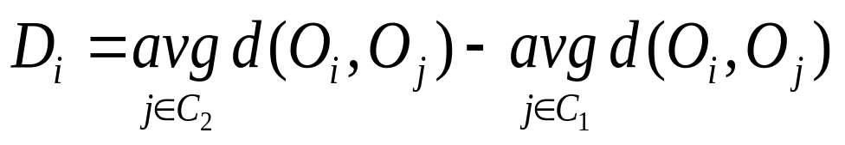
Splitting Process of DIANA (Cont’d)
Iteration:
3. For each object Oi in C2, tell whether it is more close to C1 or to other objects in C2
C2
C1
C2
C1
C2
C1
4. Choose the object O_{k} with greatest D score.
5. If D_{k}>0, move Ok from C2 to C1, and repeat 3-5.
6. Otherwise, stop splitting process.
……
C2
C1

Slide 28
Discussion on Hierarchical Approaches
Strengths
  Do not need to input k, the number of clusters
Weakness
  Do not scale well; time complexity of at least O(n²), where n is total number of objects
  Can never undo what was done previously
Integration of hierarchical with distance-based clustering
  BIRCH (1996): uses CF-tree and incrementally adjusts quality of sub-clusters
  CURE (1998): selects well-scattered points from cluster and then shrinks them towards center of cluster by a specified fraction
  CHAMELEON (1999): hierarchical clustering using dynamic modeling

Slide 29
How to Derive Clusters from Dendrogram
Use global thresholds
  Homogeneity within clusters
    Diameter(C) ≤ MaxD
    Avg(sim(O_{i},O_{j})) ≥ρ (O_{i},O_{j} ∈C)
  Separation between clusters
    Inter-cluster distance ≥ σ
      single-link
      complete-link
      …

Slide 30
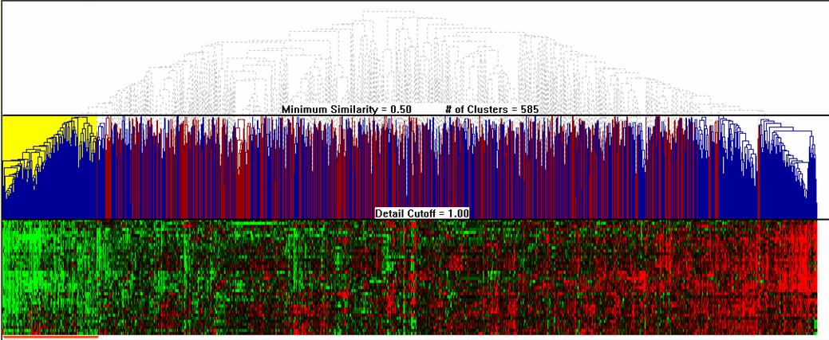
Minimum Similarity Threshold
Interactively Exploring Hierarchical Clustering Results, Seo, et al. 2002.

Slide 31
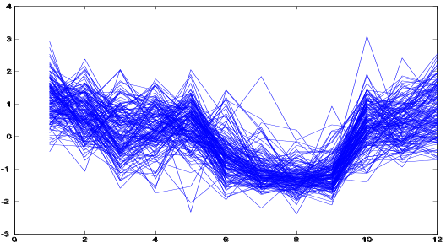
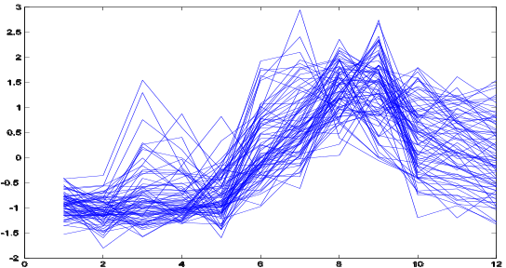
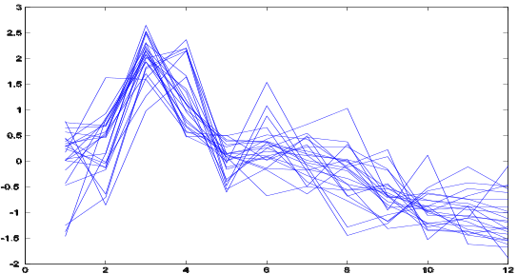
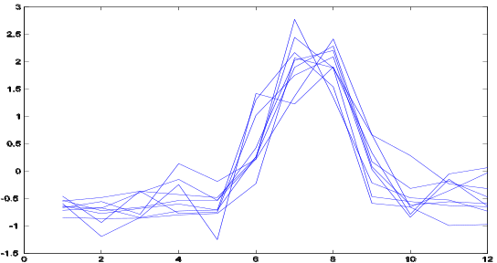
How to Derive Clusters from Dendrogram
Ask users to derive clusters
  e.g. TreeView
  Flexible when user have different requirement of cluster granularity for different parts of data.
  Inconvenient when data set is large
Coarse granularity
Fine granularity

